Slide 1



XHAUST Download program Manual
@Xhaust_official
Xhaust official
www.xhaust.kr
Xhaust

Slide 2

Contents
Contents
Prerequisite
Download Program
5 items to prepare
1
Sound update
15-18
Firmware update
19-21
Sequence
PC disconnect
Flowchart
2
Check for updates
22
Troubleshooting
Connect Module and PC
Error when executing the DLP
23
Module & PC
3
Error when logging into the DLP
24
Error when updating a sound
25
Error when updating the firmware
26
App Area
Launch App
4
Log out and re-log in
5
PC Area
Download program
6-8
USB driver installation
9-12
Launch Downloader
13-14

Slide 3

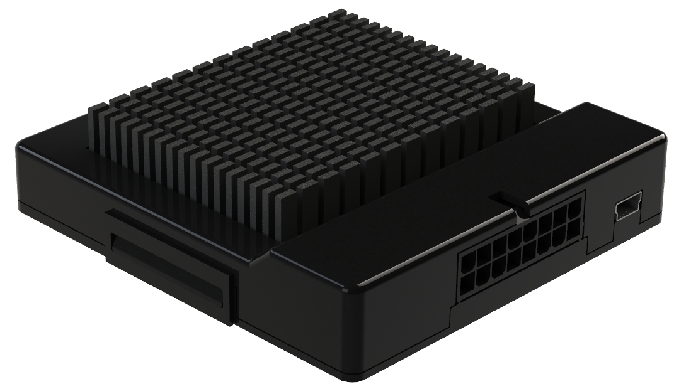

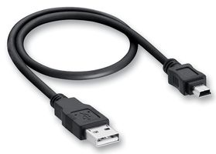

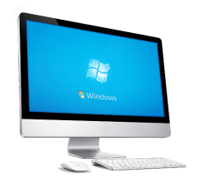
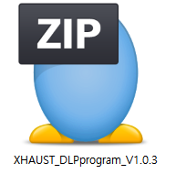

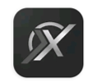

Prerequisite
1
Sequence
2
You will need the following items to use the download program.
We recommend preparing them in advance.
Connect Module & PC
1
Module
This is the XHAUST module.
If already installed in the vehicle, it must be removed and prepared.
※ For the location of the module, contact the installation shop.
APP Area
1. Launch App
2. Log out of App
3. Re-log in to the App
2
USB cable
This is a USB A / USB mini-B type cable.
It is included within the package of the product.
PC Area
3
Windows 7 and later operating system desktop
You need a computer or a laptop with Windows 7 or a
newer operating system and an Internet access. It is also
possible in WIFI environment.
1. Download DLP and usb driver
2. USB driver installation and restarting
3 DLP Execution and Login
4
Download program & USB driver program
Download program
The compressed file includes a download program (DLP) and a USB driver program. You can download it from our website.
※ Please refer to page 8.
1. Checking and updating module versions
2. Download the sound
5
XHAUST App and membership.
A smartphone or tablet with the XHAUST App installed is required.
Disconnect and use your PC

Slide 4
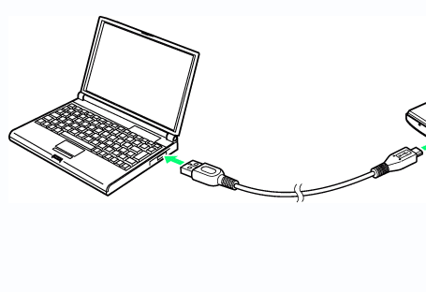

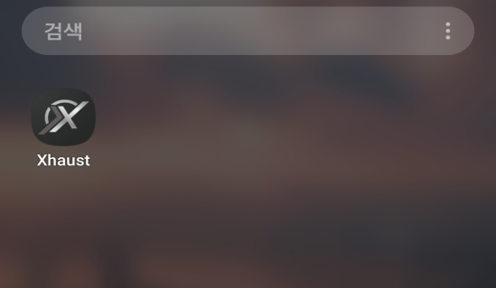
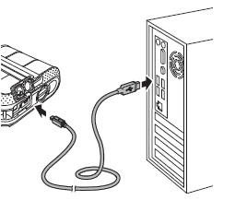
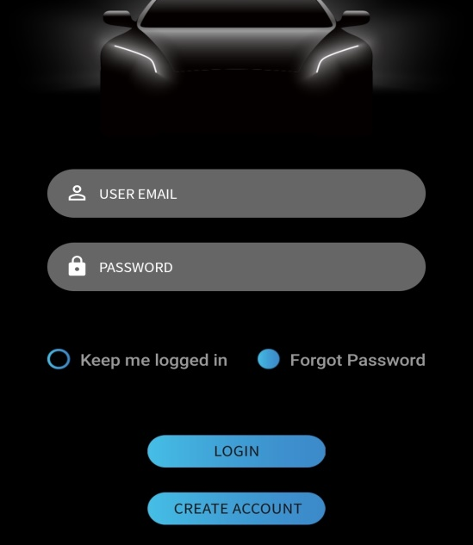
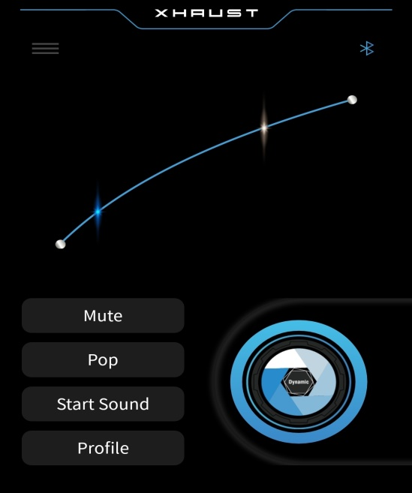

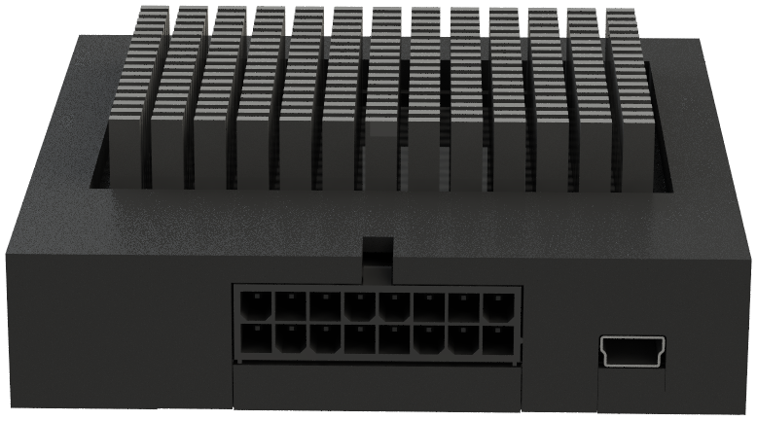
Connect Module & PC
3
APP Area > Launch App
4
Connect Module and PC
App Area
PC Area
Download program
PC disconnect
Connect Module and PC
App Area
PC Area
Download program
PC disconnect
1. Run the App on your mobile phone.
2. Enter your ID and password to log in.
The type or performance of the PC is irrelevant if the following conditions are met.
1. Windows 7 or newer operating system
2. USB A type support
3. Internet-enabled
3. Once paired successfully, go to the main screen.
Please check the Bluetooth connection mark.
When you connect your PC with the module via USB, the module displays a green LED, which is located close to the USB port. A green LED means that power is connected. If the green LED does not turn on, you must use a different USB port or another computer.

Slide 5

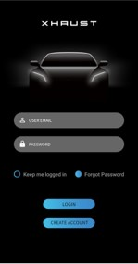

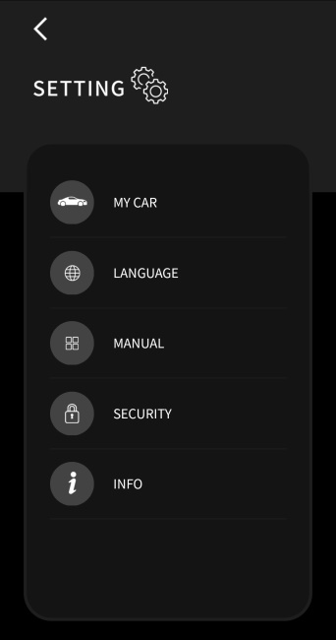
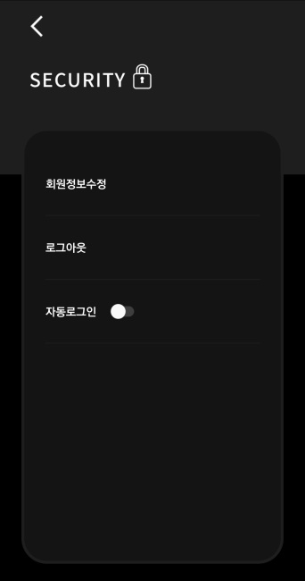

APP Area > Logout and Re-Login
5
PC Area > Download program
6
Connect Module and PC
App Area
PC Area
Download program
PC disconnect
Connect Module and PC
App Area
PC Area
Download program
PC disconnect
If the login page is omitted because you are automatically logged in to the app, you must log out manually and log in again by entering your ID & password.
There are three main ways to download the programs and drivers required:
1. Download from our website
2. Download from the shared folder of JSR Performance <XHAUST HQ>
3. Contact HQ directly to get it
When running the app for the first time, if it is paired and you are immediately sent to the main page, take the following steps:
1. Click on the Menu button to enter the Settings tab
2. Click on ‘SECURITY’
3. Click on ‘LOG OUT’
4. Log in to app by entering your ID & password

Slide 6
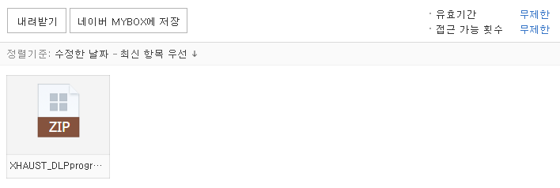
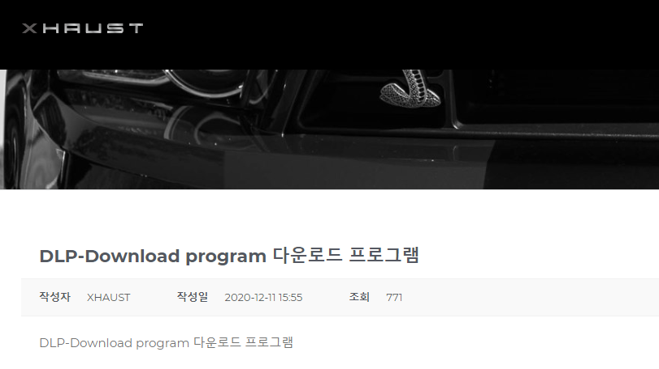
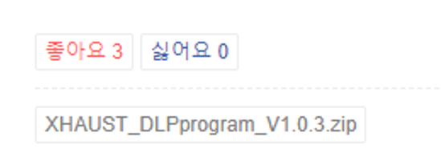
PC Area > Download program
7
PC Area > Download program
8
Connect Module and PC
App Area
PC Area
Download program
PC disconnect
Connect Module and PC
App Area
PC Area
Download program
PC disconnect
1. Download from our website
2. Download from the shared folder of JSR Performance <XHAUST HQ>
Shortcut Link
Shortcut Link
http://xhaust.kr/home/support/?uid=4&mod=document&pageid=1
http://naver.me/GKmf6fbl
1. Access the XHAUST website. (http://xhaust.kr)
2. Hover over ‘Support’, then click on ‘document’ on the top right bar of the homepage.
3. Click on ‘DLP-Download program’ in the list.
4. Click on the name of the file to download it (see below).
1. Go to the link and download the ZIP file that was uploaded to the shared folder.
(The shared folder is a space where you can share files on the network.)
3. Contact HQ directly to get it
1. You can add us as a friend on Kakao channel (XHAUST), and we'll send it to you quickly.
2. Alternatively, you can contact us via email at jsrperformance@naver.com, we will then examine your request and send the file to you.
Click

Slide 7
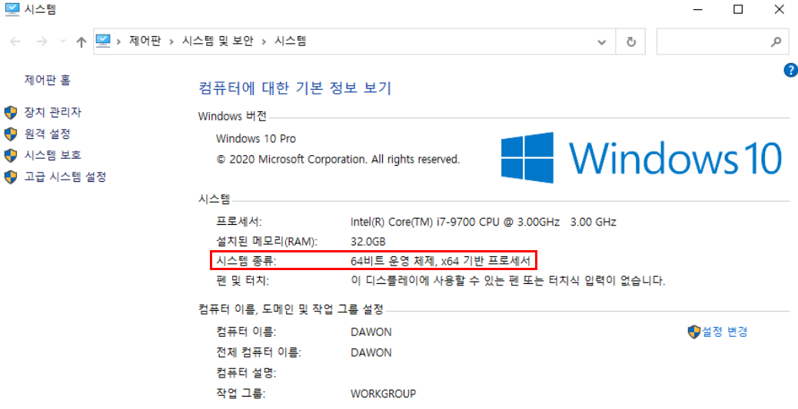
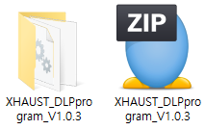
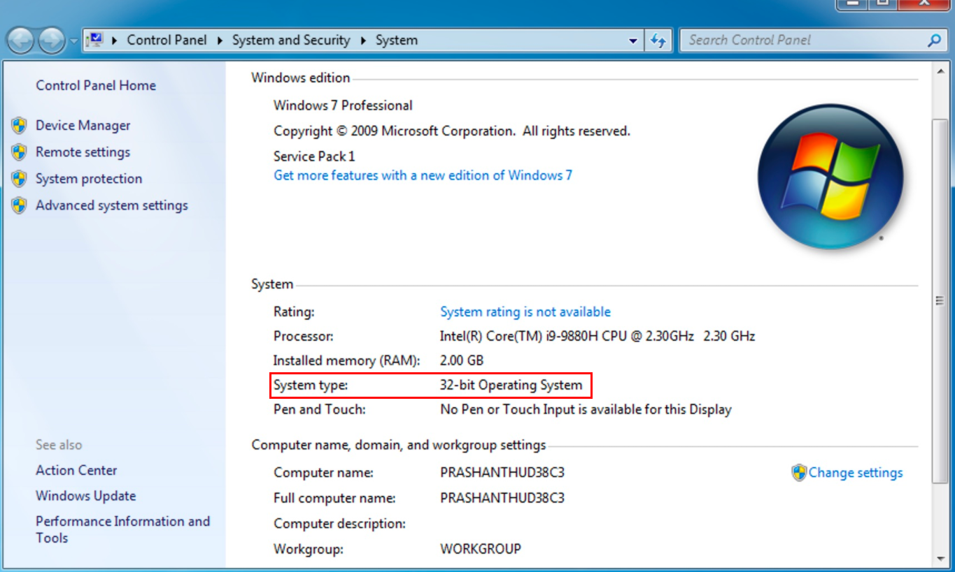
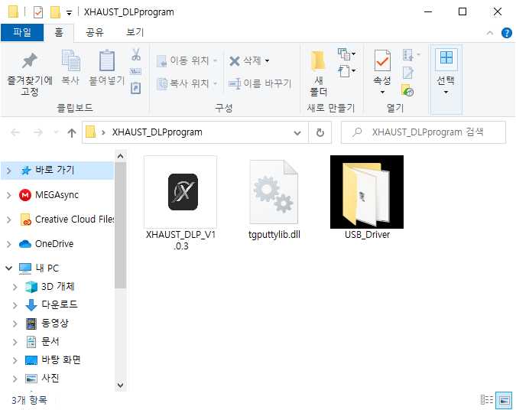
PC Area > USB driver installation
9
PC Area > USB driver installation
10
Connect Module and PC
App Area
PC Area
Download program
PC disconnect
Connect Module and PC
App Area
PC Area
Download program
PC disconnect
Before installing this program, you must first check your computer's specifications. It may vary slightly according to your version of Windows, but the generally can be found by accessing Control Panel > System.
Once you have determined whether your computer is 32-bit or 64-bit, unzip the downloaded file.
WINDOWS 10
64-bit
Unzip
WINDOWS 7
Once unzipped, you will get two or three files.
32-bit

Slide 8
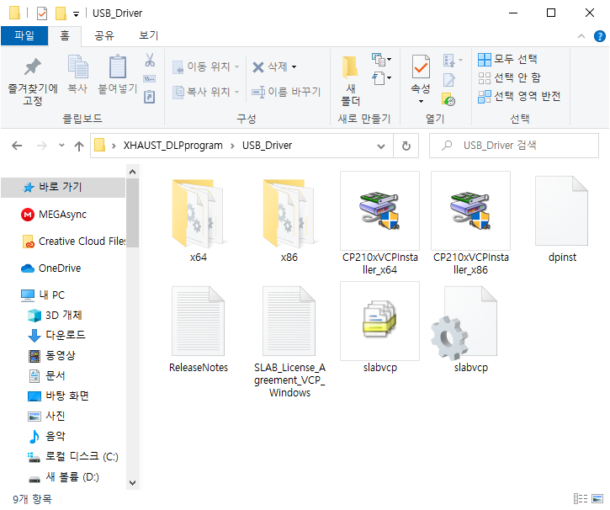
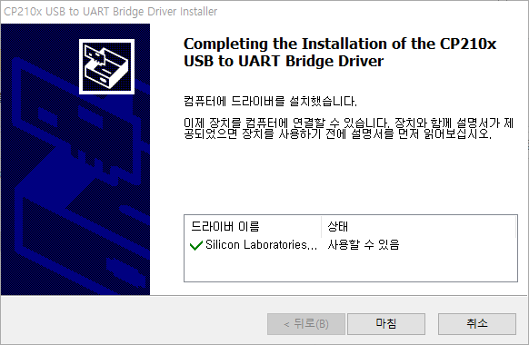
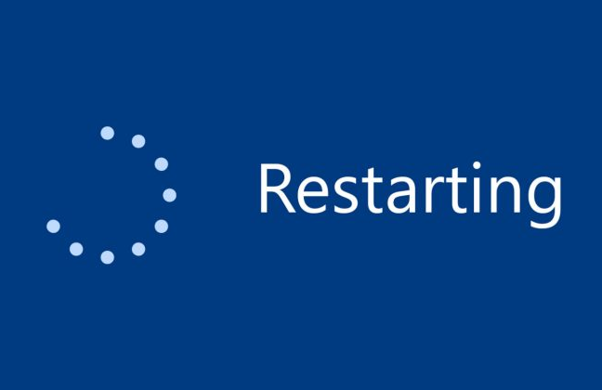

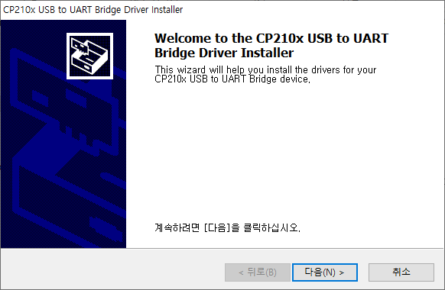
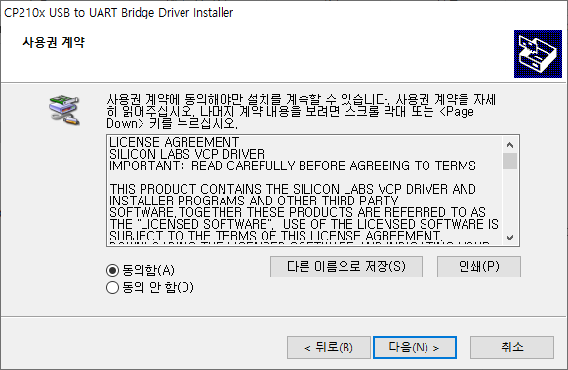
PC Area > USB driver installation
11
PC Area > USB driver installation
12
Connect Module and PC
App Area
PC Area
Download program
PC disconnect
Connect Module and PC
App Area
PC Area
Download program
PC disconnect
Driver installation method for using the MINIB USB connector.
※Driver installation only needs to be carried out once upon initial connection.
①
②
⑤
5. Check the driver status and click on ‘Finish’
6. Restart your computer after installation.
1. Open the folder 'USB_Driver'
2. Run the installation file that meets your Windows specifications (64-bit or 32-bit)
③
④
3. Click on the ‘Next (N)’ button
4. Check 'I agree (A)' and click on 'Next (N)'

Slide 9
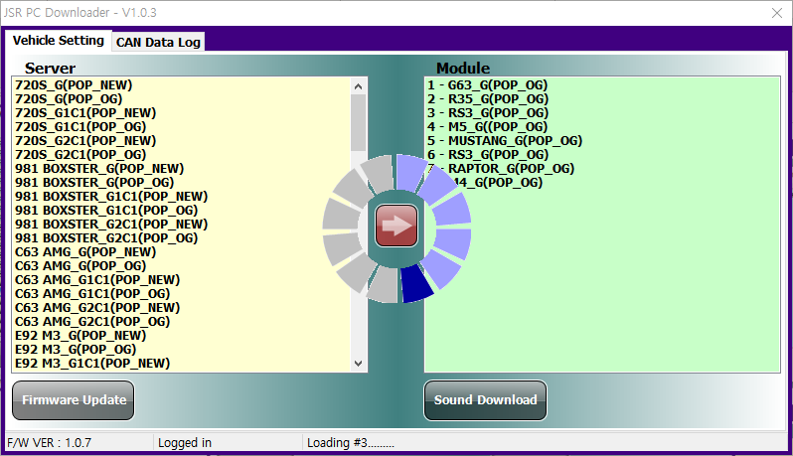
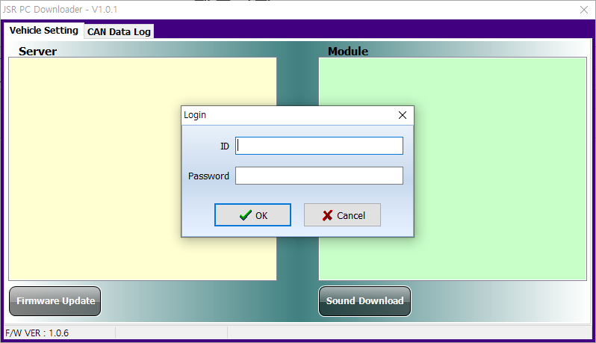
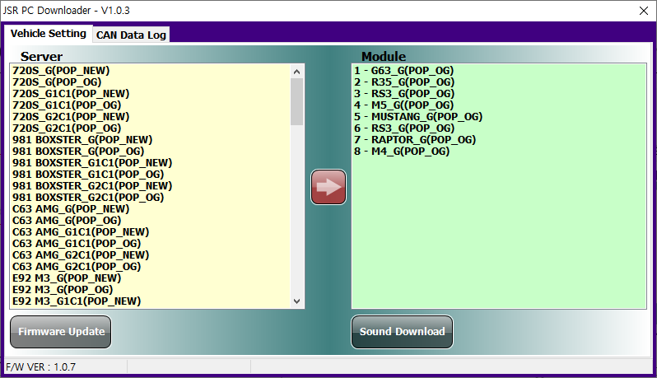
PC Area > Run DLP
13
PC Area > Run DLP
14
Connect Module and PC
App Area
PC Area
Download program
PC disconnect
Connect Module and PC
App Area
PC Area
Download program
PC disconnect
1
The login is in progress, this step usually takes about a minute.
If the USB driver is correctly installed, you can now run the download program.
3
Fill in the ID (email address) and password you used within the app, and click the ‘OK’ button.
Login is complete.
2
4

Slide 10

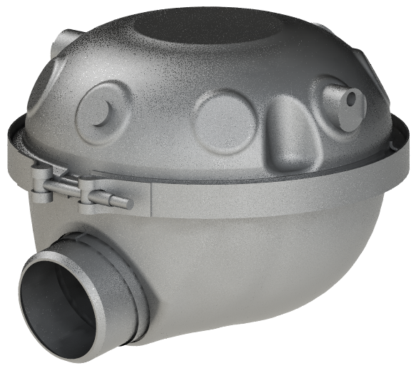
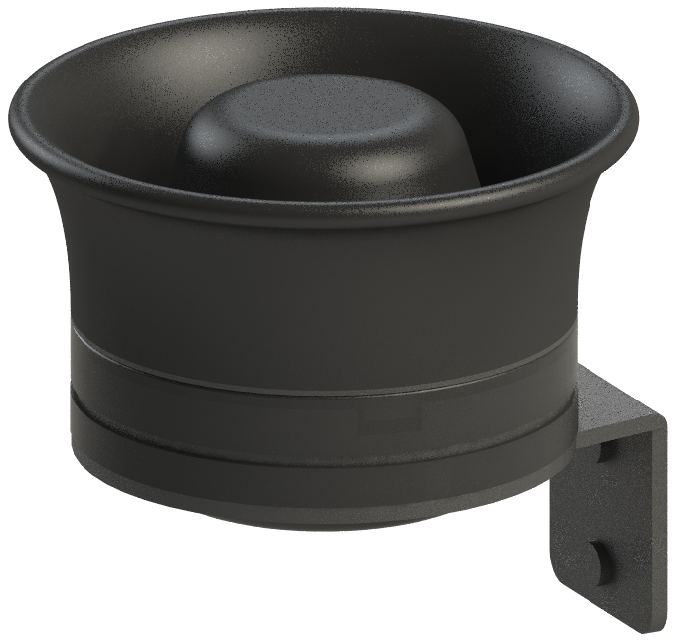
Download program > Sound update
15
Download program > Sound update
16
Connect Module and PC
App Area
PC Area
Download program
PC disconnect
Connect Module and PC
App Area
PC Area
Download program
PC disconnect
The DLP has two main functions.
1. Download sound and update firmware
2. CAN Data Transfer
This manual will only cover sound downloads and firmware updates; please refer to the dealer-only manual for CAN data transfer functions.
There are 6 files per sound. You need to find and insert the file that suits the current vehicle's speaker installation.
Sound name
- 720S
Hardware notation
- G / G1C1 / G2C1
1. Download sound
POP type
- POP_NEW (New pop)
- POP_OG (Original pop)
Downloading a sound is easy: you just have to move it from the left (Server) to the right (Module).
Hardware notation depends on the type and number of speakers.
G
(Generator)
Ex)
There are currently one or two generators installed in the vehicle.
= G
Two generators and one trble speaker are installed.
= G2C1
C
(Treble speaker)
This is the list of sounds uploaded after the development is completed.
This is a list of sounds currently stored in the module. App screen order is interlocked.

Slide 11
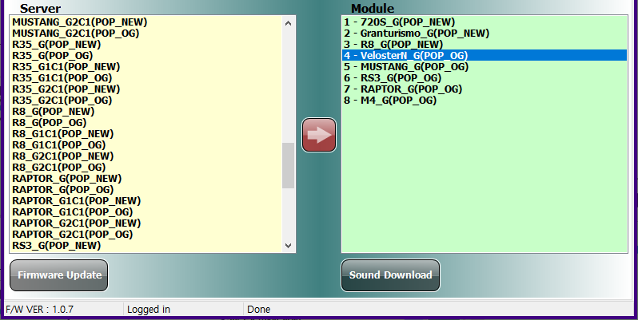
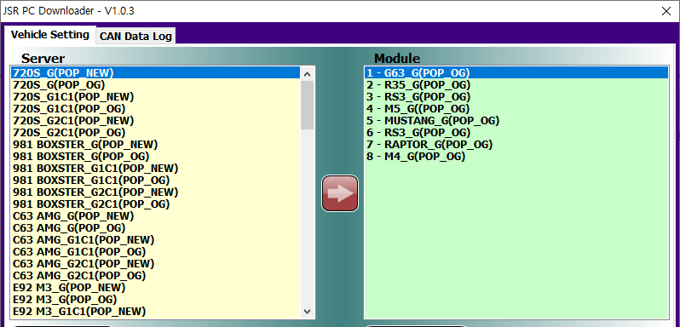

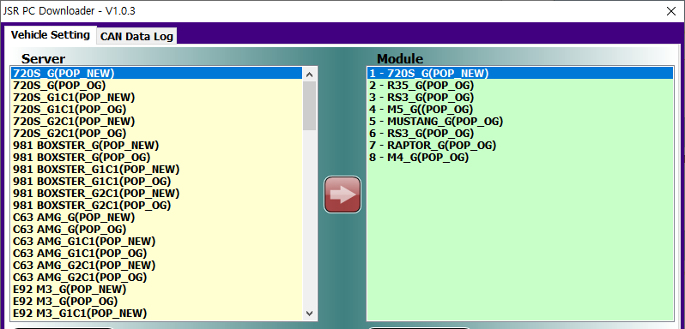
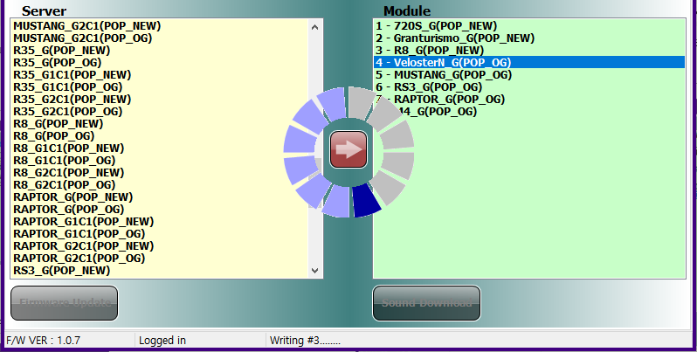

Download program > Sound update
17
Download program > Sound update
18
Connect Module and PC
App Area
PC Area
Download program
PC disconnect
Connect Module and PC
App Area
PC Area
Download program
PC disconnect
① Click on the sound you want to download in the ‘Server’ list.
② Select the location you want to allocate the sound to in the ‘Module’ list
(if the location already hosts a sound, it will be deleted).
③ Click on the arrow button to move the sound.
Move every sound you want to download in the same way.
Click on the 'Sound Download' button to download the sound list.
①
②
3
1
③
The sound list is downloading. This will take about a minute.
You can check the status of the download in the status bar to see the progression.
If there is no response, you must exit the program and force it to proceed again.
1 sound has been moved from server to module.
2
4

Slide 12
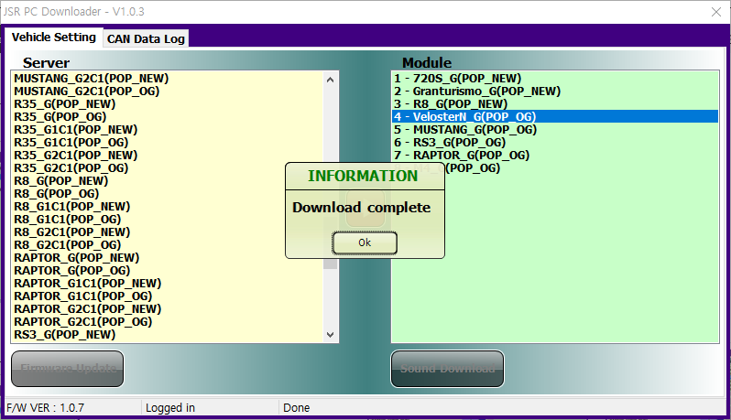
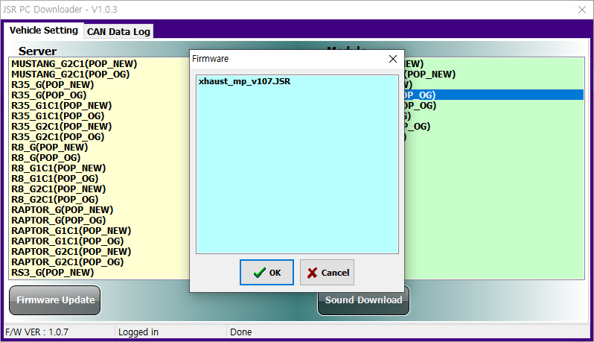
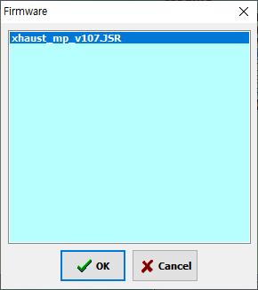
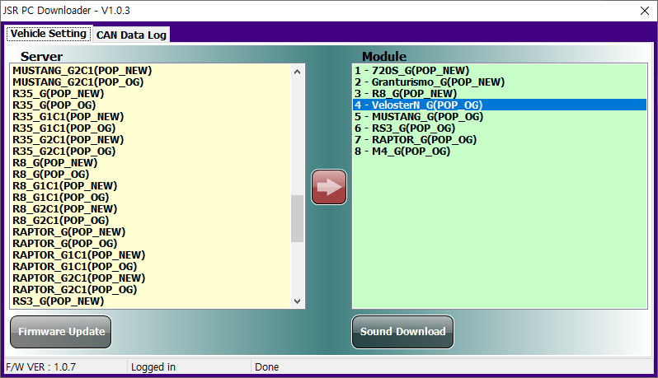
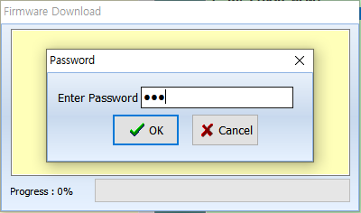
Download program > Firmware update
19
Download program > Firmware update
20
Connect Module and PC
App Area
PC Area
Download program
PC disconnect
Connect Module and PC
App Area
PC Area
Download program
PC disconnect
This message indicates that the download is completed. The sound list has been updated.
Select the latest version of the firmware (①) in the selection window, and click on the 'OK' button(②) to proceed with the firmware update.
5
①
2
②
2. Firmware update
The password is the firmware version number.
xXHAUST_mp_v107.jsr, -> password is '107'
You can check the firmware version of the module in the status bar (see below).
Click on the 'Firmware Update' button, in the bottom left corner.
1
3

Slide 13
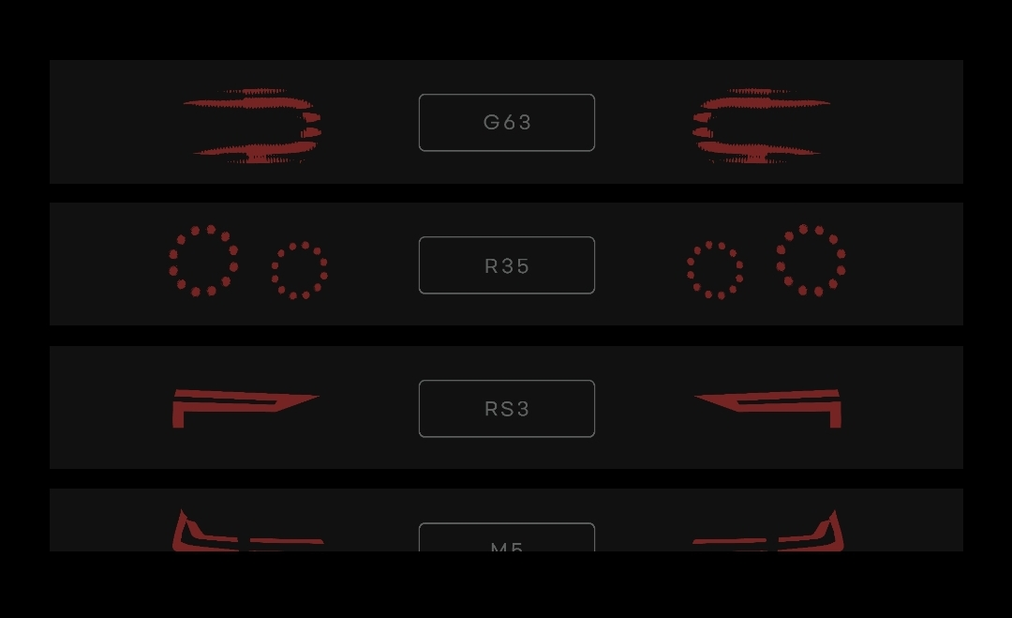
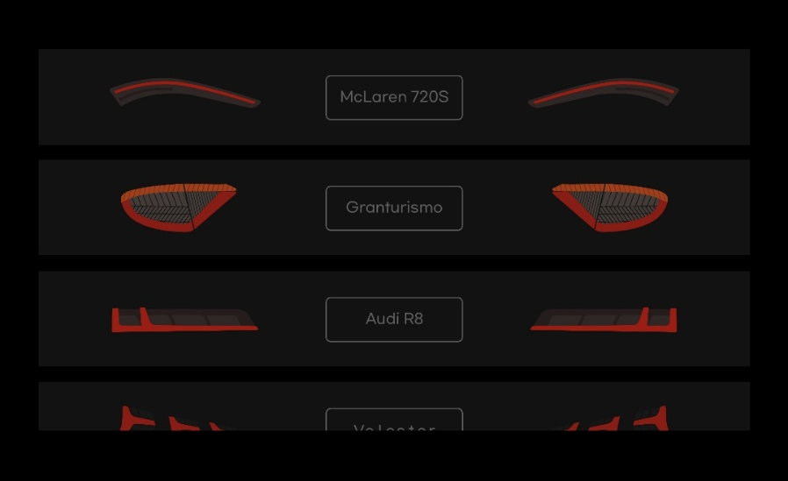
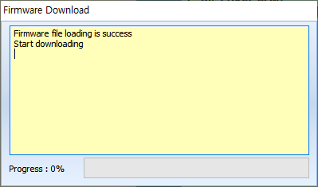

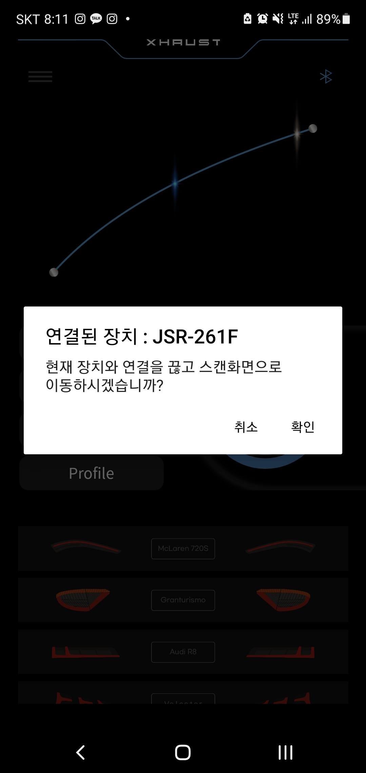
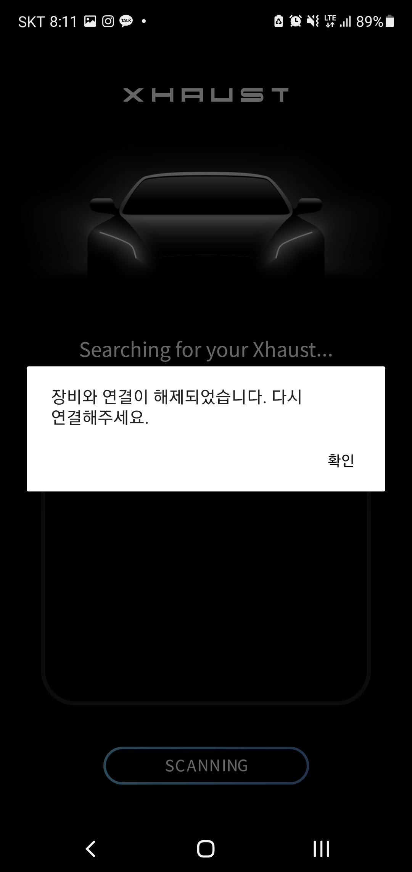
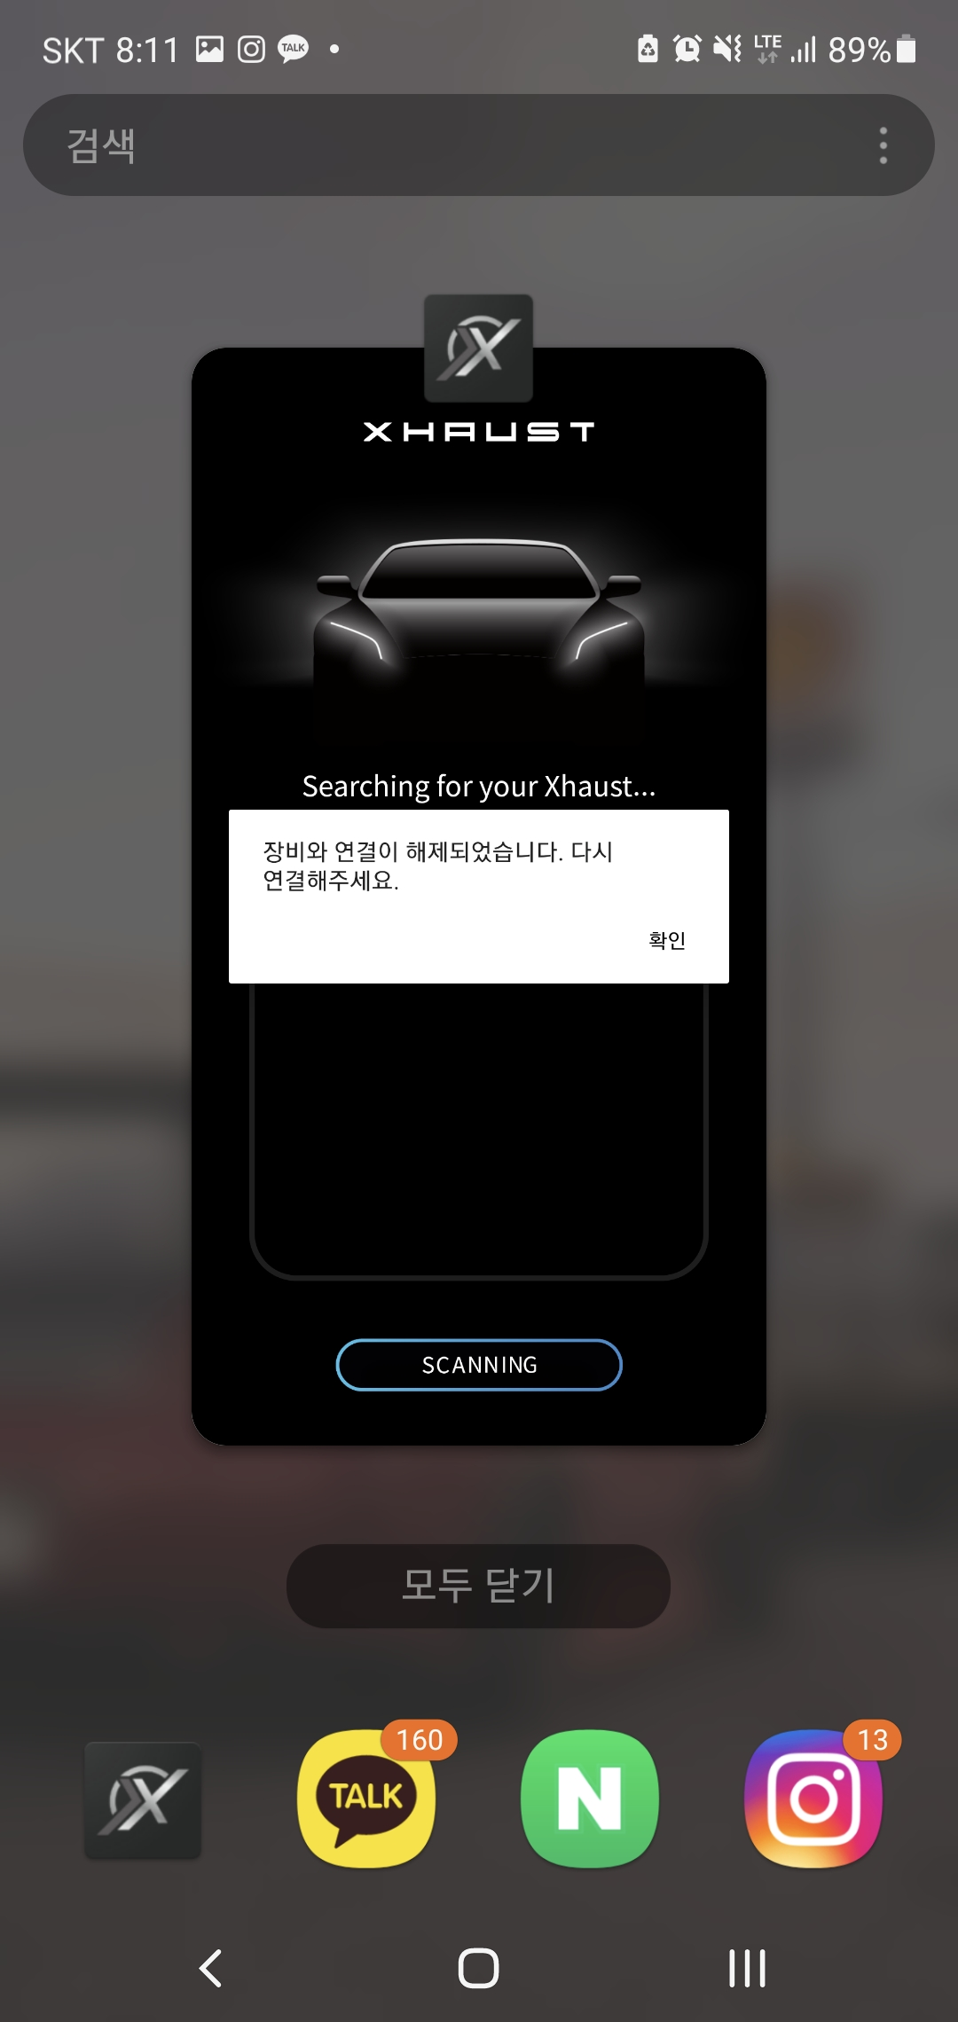

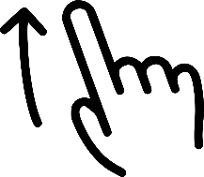
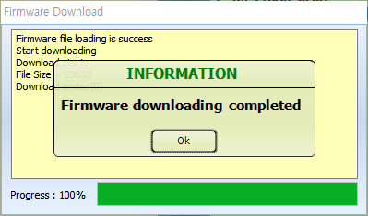
Download program > Firmware update
21
Disconnect and use your PC
22
Connect Module and PC
App Area
PC Area
Download program
PC disconnect
Connect Module and PC
App Area
PC Area
Download program
PC disconnect
Firmware update is in progress and will take about 30 seconds.
(Never disconnect the module during the update: a fatal flaw could occur and would not be covered by any warranty.)
Run the app before disconnecting the PC and module to verify that the sound list has been updated.
4
If there is no update in the sound list, press the Bluetooth icon in the upper right corner of the app to disable the Bluetooth connection, exit the app (force the closing) and run it again.
This message indicates that the download is completed. The firmware has been updated.
5
Disconnect the module and install it on the vehicle for use.

Slide 14
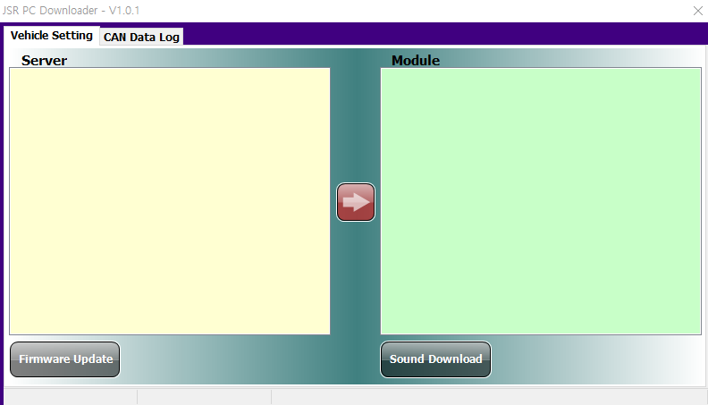
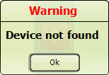



Troubleshooting > Error when executing the DLP
Troubleshooting > Error when logging into the DLP
23
24
This error message appears when the device is not properly connected.
Connect the PC and module using the USB A/USB mini-B type cable included with the product.
This message appears if there was a mistake when entering the ID or password.
There are two ways to take action when this message appears:
- Check ID/PW and re-enter them
- Log out manually and log in again (see page 5)
This error message appears when the USB driver is not properly installed.
You must install the USB driver to access the XHAUST download program.
If the program does not run, the <The DLL “SHCORE.DLL” cannot be loaded> message appears. This happens if your PC does not run under Windows 7 or a newer operating system. Please contact the head office.

Slide 15




Troubleshooting > Error when updating a sound
Troubleshooting > Error when updating the firmware
25
26
This is an example of an error due to a mismatch between the file uploaded from the server and the file in the module. You can solve it by re-downloading it as a new file on the server.
This message appears when the firmware password is entered incorrectly.
The password is the version information from the latest firmware name.
xXHAUST_mp_v107.jsr, -> password is '107'
Same
Inconsistency
Re-download has been completed as a new file on the server.
※ CAUTION - If the module is disconnected during the update, the module may no longer be operable.
Symptoms of module disconnection during update.
- The bar in the update window does not progress.
- No connection after DLP re-run (“Device not found” message appears).
If this problem occurs, the parts need to be replaced.
Part replacement induces costs.
Same

Slide 16

Thank you.
@Xhaust_official
Xhaust official
www.xhaust.kr
Xhaust

